Slide 1

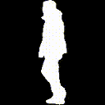
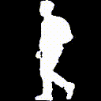
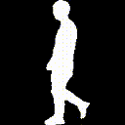
GAIT RECOGNITION BY ESTIMATING TEMPORAL ORDER OF FRAMES
Group Members:
Ankit Pal Singh (B20181)
Gayatri Kapse (B20199)
Arun Patwa (B20184)
Priyanka Kumari (B20307)
GROUP NAME: P01D
INSTRUCTOR : PROF. ADITYA NIGAM
MENTOR: SOMA CHAKRABORTY

Slide 2
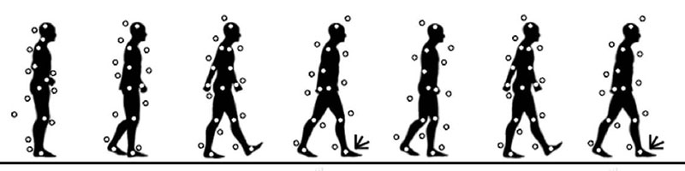
What we are doing…
Trying to recognize Human by his/her Walking Styles. ( Gait Recognition )
Gait recognition refers to the use of video of human gait, processed by computer vision methods, to recognize or to identify persons based on their body shape and walking styles. This is a passive mode of acquiring biometric data from a distance.

Slide 3
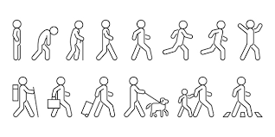
Each person have different Walking Styles
Each walking style can be captured from multiple camera views

Slide 4
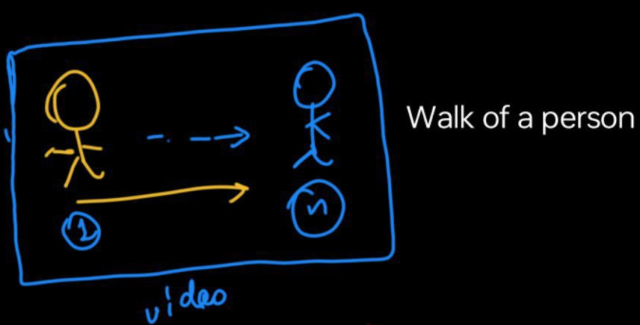
How our DataSet Looks like
A Person Walk video contains Several Frames..
Picked 50 frames from the
Video randomly

Slide 5
Our Dataset Looks like
CASIA-B
(Main Dataset)
074
001
001
001
001
001
001
Camera View
(Walking Style)
001
Frame
(Walking Style)
Frame
Camera View
Frame
Camera View
(Walking Style)
Frame
Camera View
(Walking Style)
Camera View
(Walking Style)
Person ID ‘s
Frame
(Walking Style)
Frame
Camera View
Frame
Camera View
(Walking Style)
(Walking Style)
0 degree to 180 degree
Walking Style
Frames from Video

Slide 6
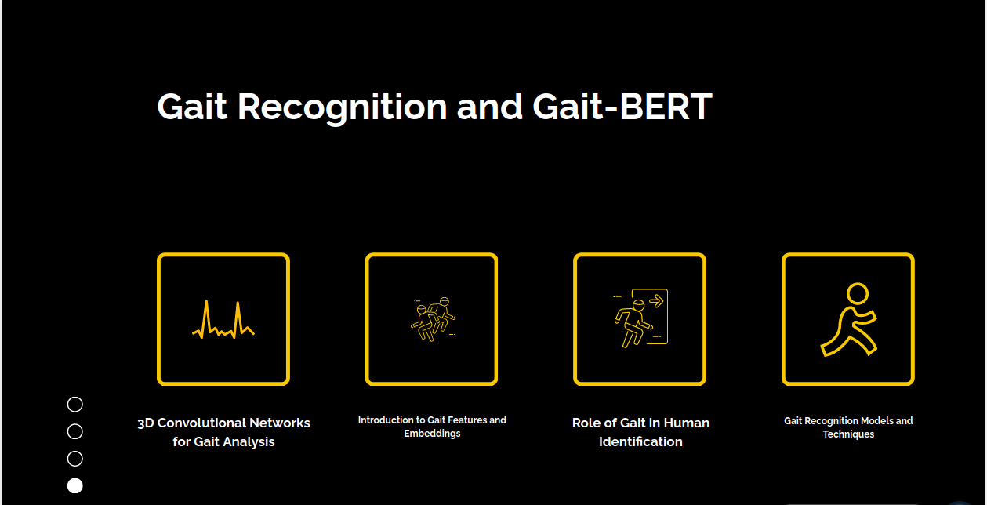

Slide 7
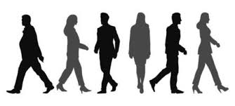
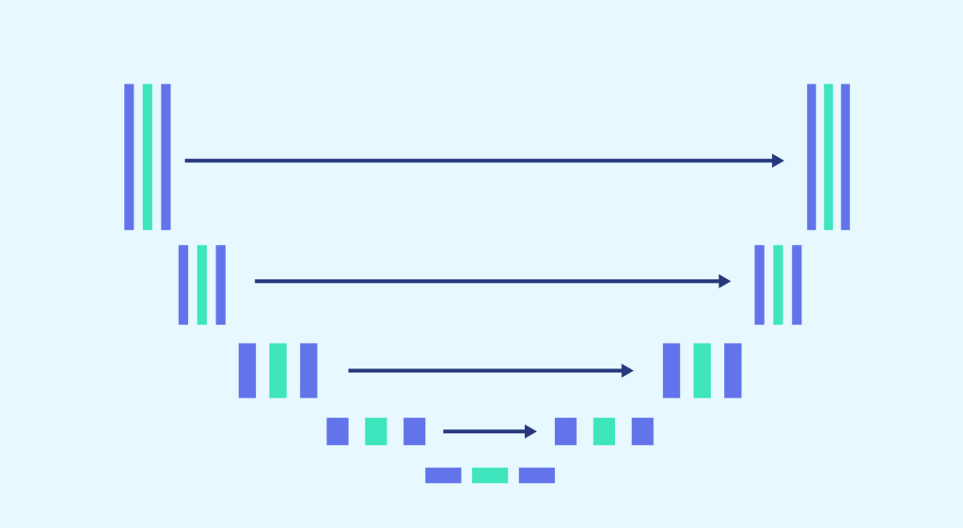
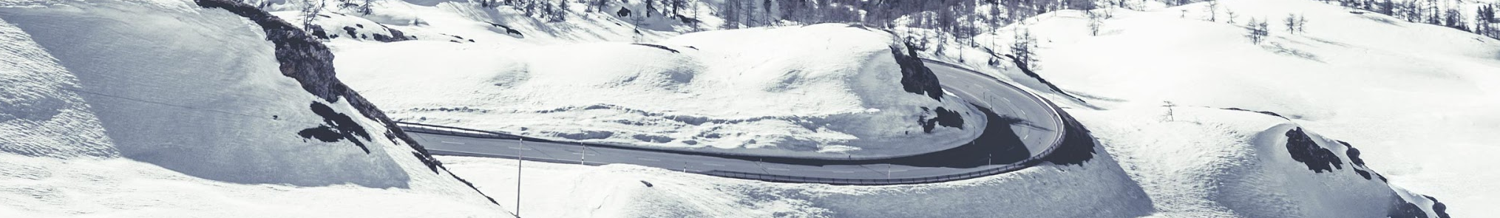
How We are approaching it ?
DataSet → CASIA-B
Model → UNET ( With 3D Convolution on random Masked Frames )
What are there to make a walking action
What variances are there in a walking action

Slide 8
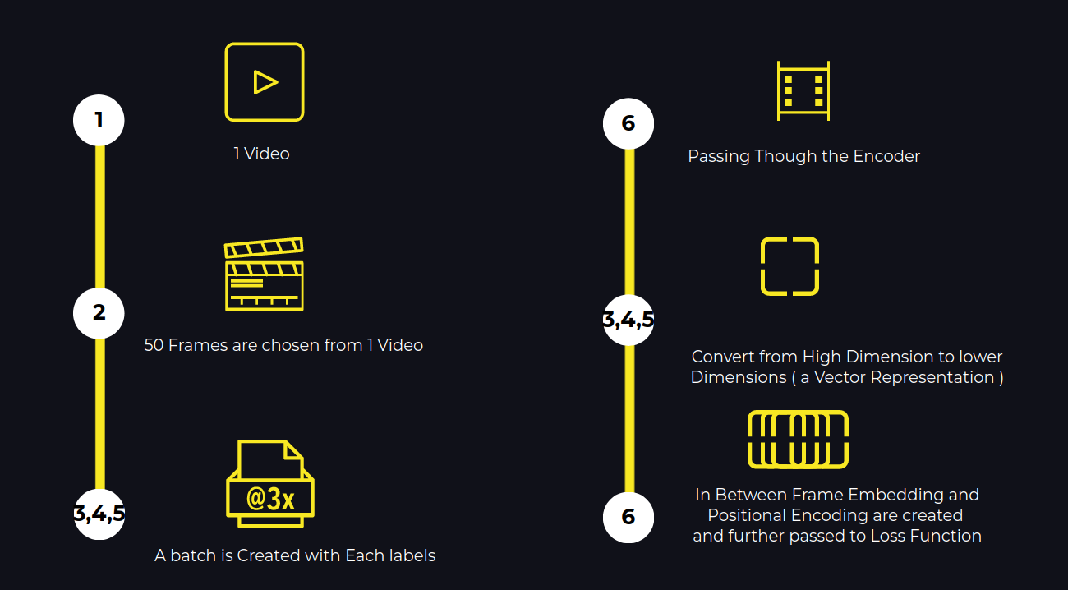
Encoder Path (Generating Embedding in low dimension Space )

Slide 9
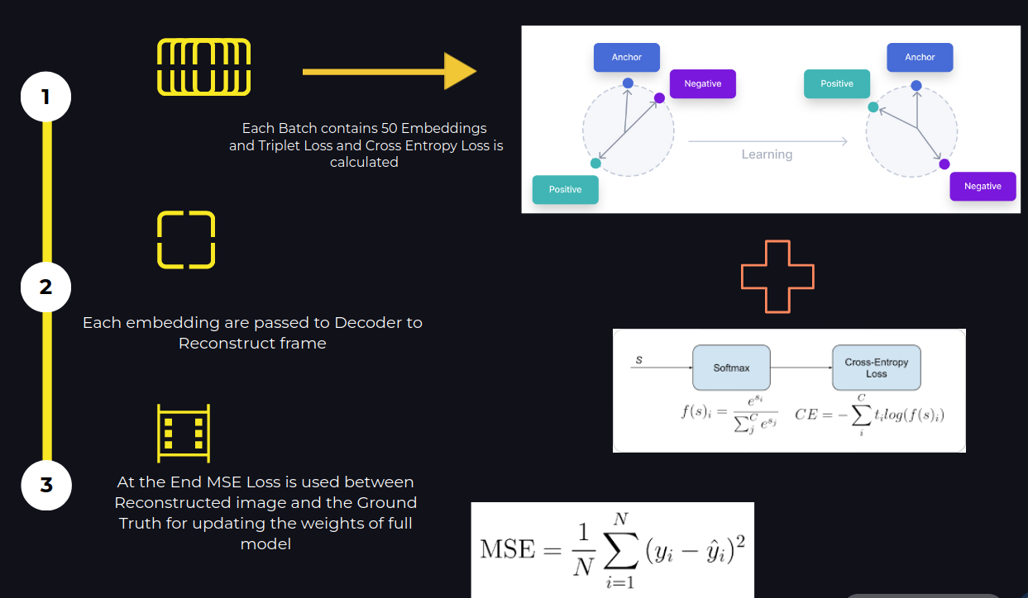

Slide 10
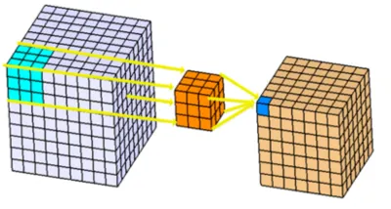
3D convolution is used
3D convolution is a convolution operation used in neural networks to process three-dimensional data, such as volumetric medical scans, video sequences, and 3D point clouds. It extends the 2D convolution by applying a three-dimensional kernel to the input data, capturing features across depth, height, and width dimensions. This allows for the extraction of spatial and temporal patterns, making 3D convolution particularly useful in fields like medical imaging for analyzing MRI and CT scans, video processing for action recognition, and 3D object detection in robotics and autonomous vehicles. The operation involves sliding the 3D kernel over the input volume, performing element-wise multiplications and summing the results to generate a 3D output feature map.

Slide 11
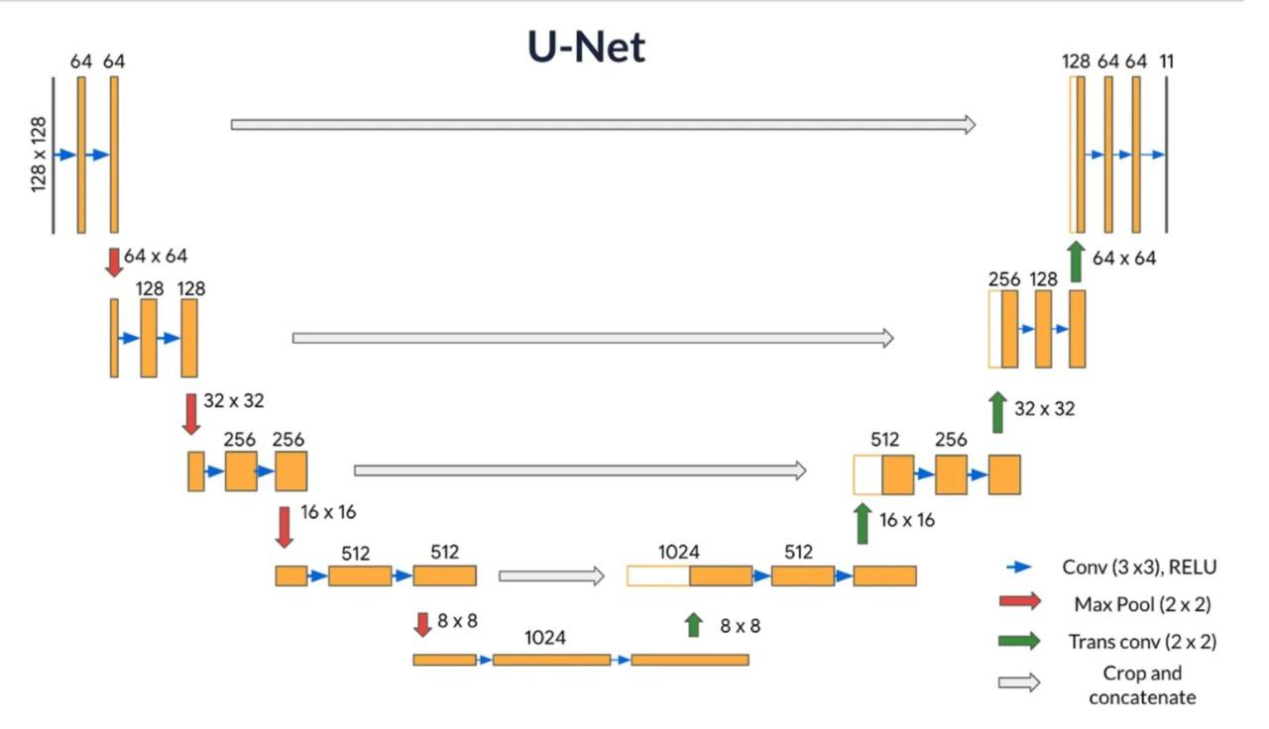
Ground Truth is Unmasked T frame
frame-0
frame-1
.
.
frame-i
(filled-up masked part )
.
.
frameTi
frame-0 “
frame-1 “
.
.
frame-i “
(filled-up masked part )
frameTi “
Frame Embedding + Positional Encoding
individual frames
Skip Connections
Regression Loss
Ground Truth is Original T frames without masks
T frame of a video of an ID { a 3D volume or seq } few in between frame will masked in random portion
Video Embedding
Triplet + Cross Entropy Loss

Slide 12
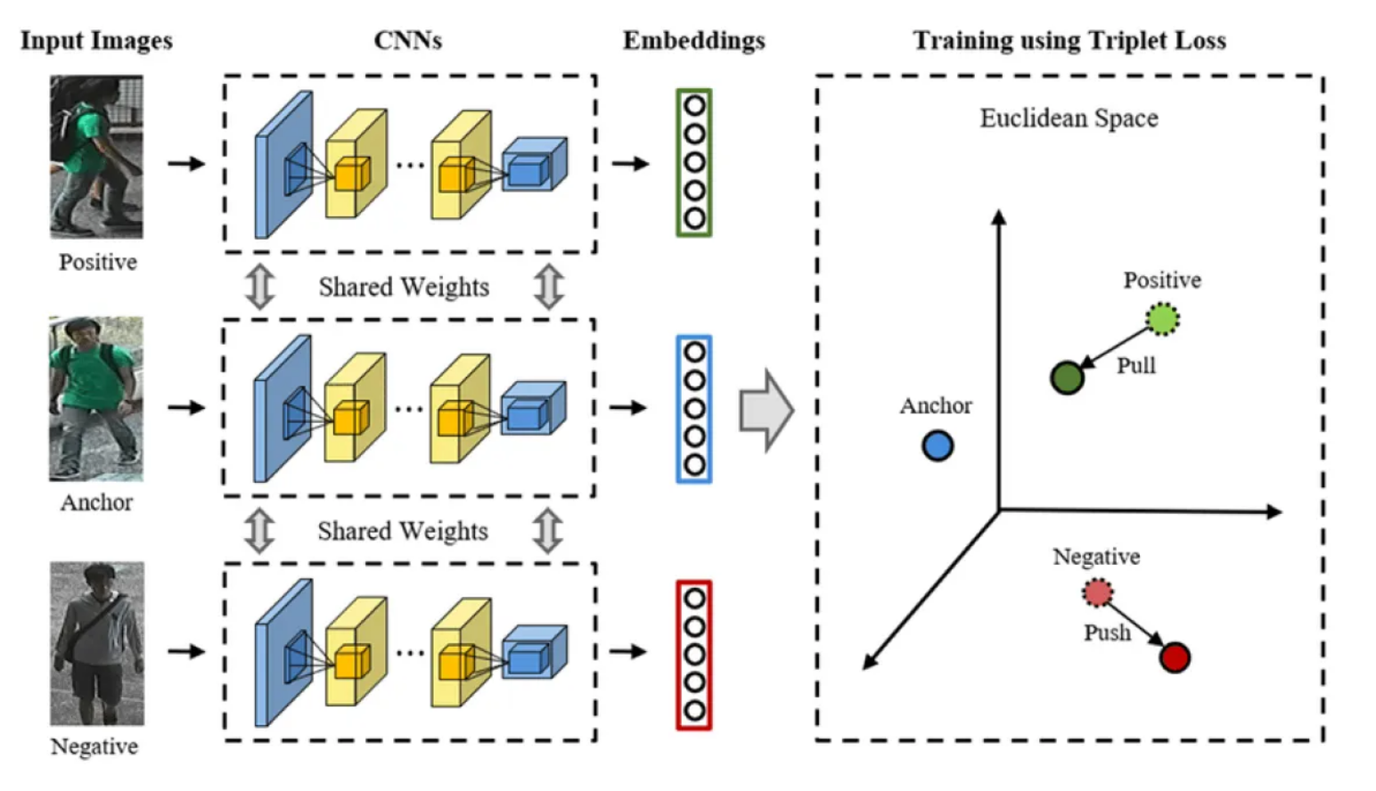
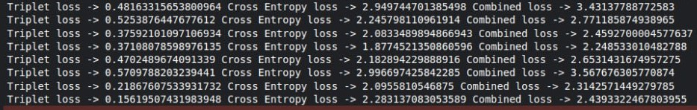
Triplet Loss
The triplet loss function compares a baseline input to positive input and a negative input in machine learning algorithms. The distance between the baseline input and the positive input is reduced to a minimum, while the distance between the baseline input and the negative input is increased.

Slide 13
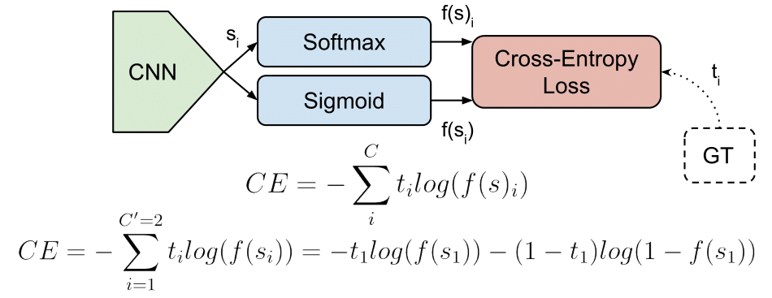
Cross - Entropy Loss
Cross-entropy loss also known as log loss is a metric used in machine learning to measure the performance of a classification model. Its value ranges from 0 to 1 with lower being better. An ideal value would be 0. The goal of an optimizer tasked with training a classification model with cross-entropy loss would be to get the model as close to 0 as possible

Slide 14
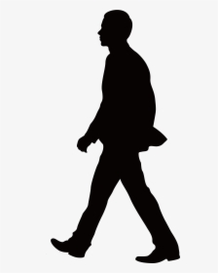
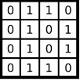
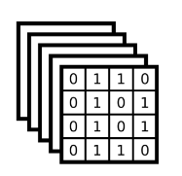
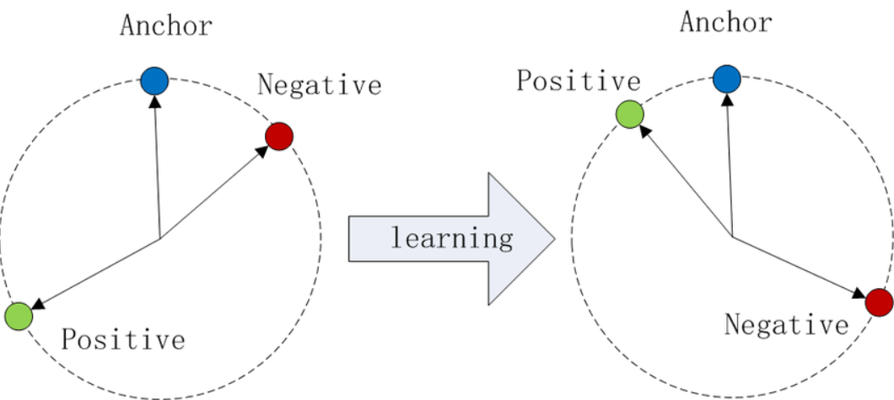
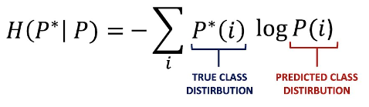
GaitBERT ( Gait Recognition by Predicting Masked Frames Encoder Path)
Frame
Frame
Encoder
Frame
Frame
Frame
Frame
RandomlyMasked Frame
Embedding
Image
[50,50,1,64,64]
each tensor batch is represented
Cross Entropy Loss
Stacks of Embeddings
Triplet Loss
Combined Loss

Slide 15
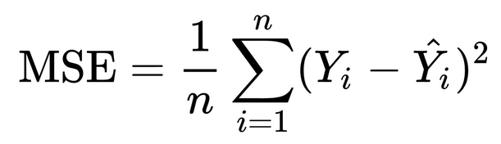
GaitBert ( Decoder Path )
Reconstructed
Ground Truth
Decoder
Embedding of a frame
Stacks of Embeddings
[50,50,1,64,64]
each tensor batch is represented

Slide 16
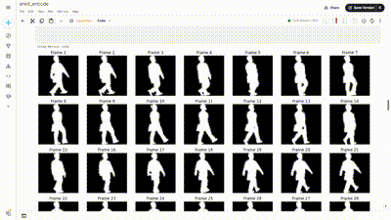
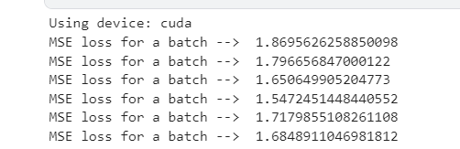
Reconstruction of Video and MSE Loss for the Whole Network

Slide 17
In what way Masking can help us !
Robust Feature Learning: Masking random frames forces the model to learn stronger and more generalized features.
Enhanced Video Embedding: Accurately predicting masked frames results in a more detailed and comprehensive video embedding.
Ground Truth Comparison: The model uses the original unmasked frames as ground truth for training, improving its predictive capabilities.
Loss Functions: Utilizes cross-entropy loss for frame prediction accuracy and triplet loss for distinguishing between different individuals.
Segmentation and Reconstruction: Outputs a segmentation map that fills in masked parts, using regression losses to fine-tune predictions.
Gait Pattern Understanding: Improves the model's ability to recognize and represent unique gait patterns for better gait recognition.

Slide 18
Positional Encoding and Frame embedding
Frame embedding captures essential gait features in a compact form, enhancing recognition accuracy.
Positional encoding maintains the temporal order of frames, improving the model's ability to predict and reconstruct masked frames.

Slide 19
Thank you.

